Slide 1
SEQUENTIAL CIRCUITS
COMPUTER SYSTEM ARCHITECTURE
BY:
ROSHNI PATOA

Slide 2
INTRODUCTION
The sequential circuit is a special type of circuit that has a series of inputs and outputs. The outputs of the sequential circuits depend on both the combination of present inputs and previous outputs. The previous output is treated as the present state. So, the sequential circuit contains the combinational circuit and its memory storage elements. A sequential circuit doesn't need to always contain a combinational circuit. So, the sequential circuit can contain only the memory element.

Slide 3
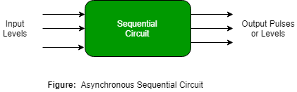
TYPES OF SEQUENTIAL CIRCUITS
Asynchronous Sequential Circuit
These circuits do not use a clock signal but uses the pulses of the inputs. These circuits are faster than synchronous sequential circuits because there is clock pulse and change their state immediately when there is a change in the input signal. We use asynchronous sequential circuits when speed of operation is important and independent of internal clock pulse.

Slide 4
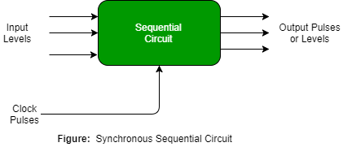
TYPES OF SEQUENTIAL CIRCUITS
Synchronous Sequential Circuit
These circuits uses clock signal and level inputs (or pulsed) (with restrictions on pulse width and circuit propagation). The output pulse is the same duration as the clock pulse for the clocked sequential circuits. Since they wait for the next clock pulse to arrive to perform the next operation, so these circuits are bit slower compared to asynchronous. Level output changes state at the start of an input pulse and remains in that until the next input or clock pulse.

Slide 5
CLOCK SIGNAL AND TRIGGERING
Clock signal is a kind of control signal that allows the elements of synchronous circuits to be in phase or phenomena that occur in circuits. It is derived from the square wave that has a high and a low level, it helps in measuring the sequential changes in the circuit states. The clock signal also makes a pulse simultaneously on all the circuit parts that are needed for the proper work of synchronous sequential circuits.

Slide 6
TYPES OF TRIGGERING
In Sequential circuits, triggering denotes the way, in terms of which the state changes take place. There are two main types of triggering.
Level Triggering
Level triggering happens when the change of state is from the level of the clock signal is high or low. The circuit depends on the level of the clock signal rather than the rising or the falling edge of it. There are two types of level triggering:
Positive Level Triggering: The circuit changes state when it is high time in the clock cycle i.e. when the clock signal is high.
Negative Level Triggering: The circuit changes state when the clock signal is in the low state.

Slide 7
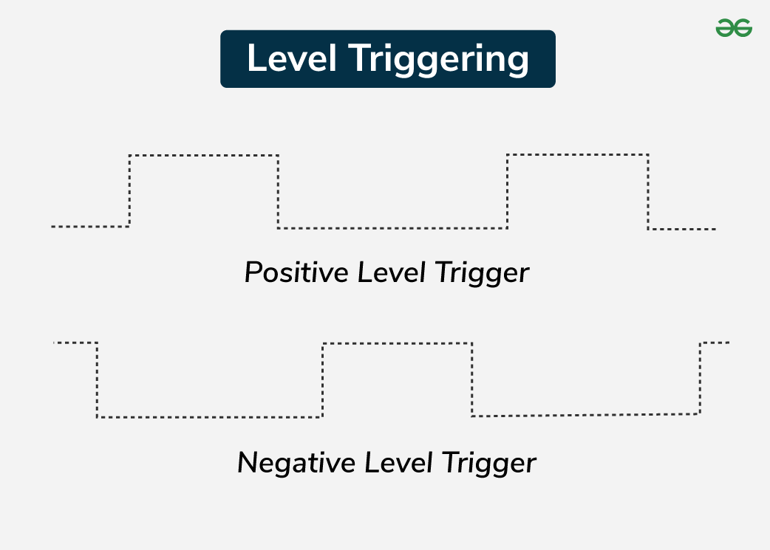
TYPES OF TRIGGERING

Slide 8
TYPES OF TRIGGERING
Edge Triggering
Edge triggering occurs when the state change is initiated by the transition (rising or falling edge) of the clock signal. The circuit responds to the clock signal’s edges rather than its levels. There are two types of edge triggering:
Positive Edge Triggering: The circuit changes state on the rising edge (transition from low to high) of the clock signal.
Negative Edge Triggering: The circuit changes state on the falling edge (transition from high to low) of the clock signal.

Slide 9
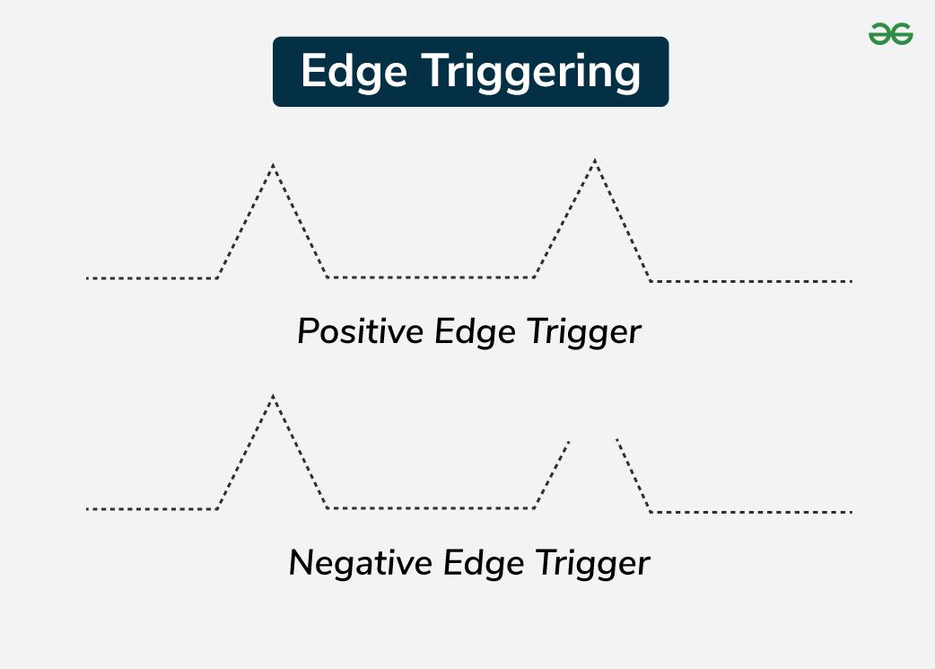
TYPES OF TRIGGERING

